Slide 1
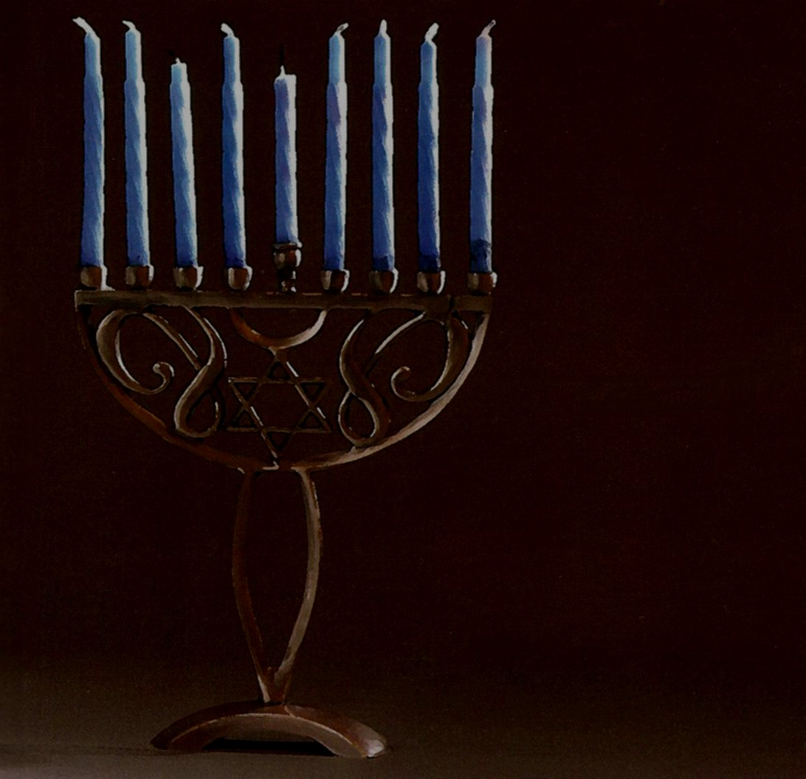
The FEAST OF DEDICATION
Investigating the Biblical origins of Dedication

Slide 2

The Feast of Dedication
The name Hanukkah derives from the Hebrew verb חנך meaning to dedicate
The Feast of Dedication is mentioned in John 10:22
The festival is also called Lights (Jos. Antiq 12.7.7)
It is observed for eight nights, starting on the 25th day of Kislev (approximately December)

Slide 3
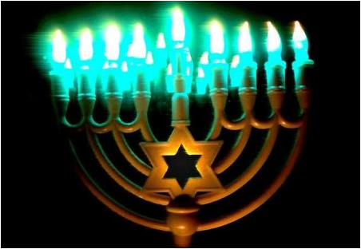
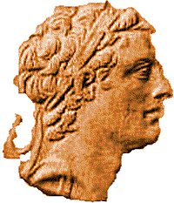
Origins of the Feast
Antiochus IV
Epiphanes
Upon the death of Alexander the Great his Greek empire split into four provinces ruled by his generals: Ptolemy in Egypt, Seleucus in Babylon, Cassander in Macedonia, and Lysimachus in Thrace. Antiochus the Great, king of Syria, became the 6th ruler of the Seleucidan dynasty and father of Antiochus IV Epiphanes. Antiochus IV Epiphanes ascended to the Seleucid throne in 175 BC to become the Greek Syrian king.

Slide 4
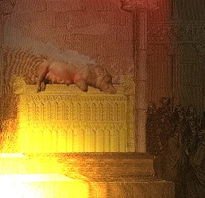
"On the fifteenth day of Chislev, in the one hundred and forty-fifth year (167 B.C) he erected a devastating desecration on the altar of burnt offering.“ ( I Maccabees 1:54)
"...The Seleucid King Antiochus IV Epiphanes, modelling himself on Alexander, tried to impose a universal Hellenistic religion by the abolition of the Sabbath rest day, the prohibition of circumcision, the erection of Zeus' statue [fashioned in his own likeness] in the Jerusalem Temple, and the sacrifice of pigs on the Temple altars. Antiochus dealt forcefully with dissidence, destroying Jewish scriptures and burning alive anyone caught living by the rules of the Torah.” - Ian Wilson, Jesus, The Evidence

Slide 5
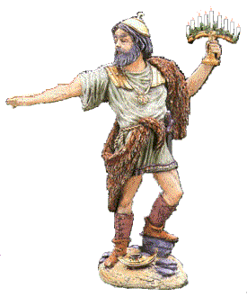
The Maccabees rebelled against the Hellenic Seleucid dynasty and founded the Jewish Hasmonean dynasty that fought for Jewish independence from 165-63 BC. In 167 BC, Mattathias revolted against the Greek occupiers by refusing to worship the Greek gods. He killed a Hellenizing Jew who was willing to offer a sacrifice to the Greek gods. Mattathias and his five sons fled to the wilderness of Judea. Later Mattathias’s son Judas Maccabaeus led an army against the Seleucids and won. He entered Jerusalem, cleansed the Temple, and re-established Jewish worship. Hanukkah is thought to commemorate this victory.

Slide 6
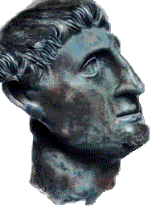
Antiochus IV Epiphanes typified the Antichrist . The Syrian king Antiochus demonstrated the same ruthless ambition and hubris as the earlier Assyrian king Sennacherib who invaded Judea during the reign of Hezekiah (the suffering servant, a type of the Messiah) - the author of Daniel highlights the antitheses:
Antichrist | Christ
“Shall destroy (corrupt) wonderfully” (Dan.8:24) | “His name shall be wonderful counsellor” (Isa. 9:6)
“By peace destroy (corrupt) many” (Dan.8:25) | “Prince of peace” (Isa. 9:6)
“And his power shall be mighty” (Dan.8:24) | “Mighty God” (Isa. 9:6)

Slide 7
Antiochus IV Epiphanes assumed divine epithets, which no other Hellenistic king had done, such as Theos Epiphanes (God Manifest) and after his defeat of Egypt, Nikephoros (Bearer of Victory). But his often eccentric behaviour, capricious actions and even insanity led some of his contemporaries to call him Epimanes ("The Mad One"), a word play off of his title Epiphanes.

Slide 8

Pre-Maccabean origins of Lights
The Festival supposedly originated with the rededication of the Temple in Jerusalem at the time of the Maccabean Revolt of the 2nd century BC. The pedigree of the feast is however far more ancient as A. Edersheim notes: “From the hesitating language of Josephus we infer that even in his time the real origin of illuminating the Temple was unknown”. Rabbi Michael Graetz observes that, "No historical source about the Maccabean wars, or of the original celebration of Hanukah mentions 'lamps', YET it is clear from Josephus (Antiquities 12:325), and even more so from the Mishnah (BK 6:6), that it was a universal, well-known and accepted custom of all Jews to light 'Hanukah lamps', special oil lamps for Hanukah, and place them in front of their doors”.

Slide 9
The eight day festival, with its custom of illuminating the houses, to the miracle that is said to have occurred at the dedication of the purified Temple. This was that the one small cruse of consecrated oil found unpolluted by the Hasmonean priests when they entered the Temple, it having been sealed and hidden away, lasted for eight days until new oil could be prepared for the lamps of the holy candlestick. However Karaite Jews, who hold to the Torah and reject the oral law of the Rabbi's, point out that the winter solstice festival was already a pagan festival that was adopted by the Jews: Such festivals were typically celebrated by the lighting of candles, oil lamps, or other forms of fire in order to help strengthen the “sun god” — who had been growing weaker and weaker as the winter solstice approached — in order that the sun might return and bring back its light and warmth, allowing the crops to grow once again.

Slide 10
Other peoples and religions have winter solstice holidays lasting about 8 days, beginning at about the time of the Winter equinox, December 21 – the shortest day of the year in the Northern hemisphere, and often celebrated with lights. Holidays that are certainly or possibly related to the winter solstice in their origins include Christmas, the ancient Roman holiday of Saturnalia.
According to Ewald (Gesch.des Volkes Israel,3d ed.,iv.407) and Wellhausen (Israelitische und Jüdische Gesch.p.210;comp.Paulus Cassel, "Weihnachten."pp. 57,97, and p.lii., notes) it had been celebrated as the winter solstice feast by the Jewish people before it became a historical festival associated with the great Maccabean victory.

Slide 11

Summary
Gentiles celebrated the winter solstice as a festival
Antiochus desecrated the Temple on the 25th of Kislev during the pagan winter solstice
The Maccabees cleansed and dedicated the Temple three years later on the 25th of Kislev

Slide 12
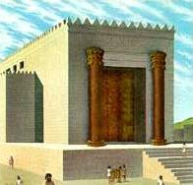
The facts point to the Maccabees adapting a pagan festival - that the Maccabees also associated the Feast with the 8 day feast of Tabernacles (2 Macc.10,6-8; also 1 Macc.4,49-57; 2 Macc.1,8;10,3) testifies to their efforts to popularize the feast. However, the origins of the feast lie far earlier than the Maccabee period. The suggestion is that the feast originated with the dedication of Zerubbabel’s temple under the exhortation of the prophets Haggai and Zechariah.
“Consider now from this day forward, from the twenty-fourth day of the ninth month, from the day that the foundation of the LORD's temple was laid -- consider it…………. But from this day (25th of Kislev) I will bless you” (Hag 2:18-19)
This may account for 2 Macc1.18 et seq., which although legendary probably preserves historical material when it relates the miraculous relighting of the altar-fire by Nehemiah on the twenty-fifth of Kislev ,and which appears to be given as the reason for the selection of the same date for the rededication of the altar by Judas Maccabeus

Slide 13
Even more pertinent to Hanukkah is the vision of the two “sons of oil” revealed to the prophet Zechariah:
“Then I answered and said to him, "What are these two olive trees -- at the right of the lampstand and at its left?"………..so he said, "These are the two anointed ones, who stand beside the Lord of the whole earth.“ (Zech 4: 11,14)
Numbers 7 is read over the eight feast days of Hanukkah supplemented with Zech 2:14-4:7 on the first Sabbath in Hanukkah.The two anointed ones that feed the seven branched menorah are depicted as two lampstands in Revelation. Therefore the two “olive trees” become synonymous with the “two lampstands”:
“These are the ﻿﻿two olive trees and the two lampstands standing before the ﻿﻿God of the earth”. (Rev 11:4)

Slide 14
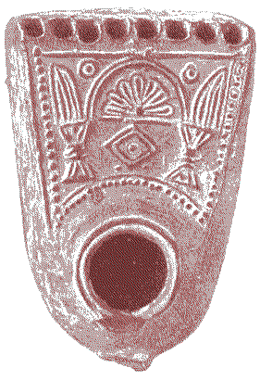
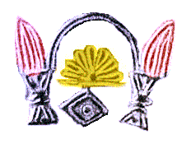
It might be argued that Revelation represents a late Christian innovation in which the two olive trees of Zechariah’s vision become two lampstands, however, it is evident that the Hanukkah candelabra (Hanukkahiyya) has nine lamps. This represents the seven branched menorah with the addition of the two lamps from the Zechariah vision.
Designs on this early Hanukkah lamp excavated at Jerusalem show a distinctive pattern of two lamps with a Menorah in the centre – note the nine wick-holes in the lamp. Revelation 11:4 is therefore not an innovation; it was based on underlying traditions found in Judaism. Moreover, Revelation 11 alludes to Hanukkah as verse 1b speaks of the dedication of a Temple – the theme of the Feast of Lights: “Rise and measure the temple of God, the altar, and those who worship there”.

Slide 15
For some time Psalm 30 was sung by the Levites in the Temple. The Psalm has the title, “A song of the Dedication (Hebrew Hanukkah) of the house [a psalm?] of David.” The Psalm may well contain early tradition from David occasioned by the bringing of the ark to Jerusalem (see G.Booker) although Solomon’s temple was built and dedicated after David’s death. The psalm also contains reminiscences of Hezekiah’s near death experience and a possible rededication of the temple after the Assyrian pollutions. It was probably written by David and adapted by Hezekiah for re-dedicating the temple. Whatever the origins, the Psalm was also recited at Hanukkah in the synagogue (Masseket Soferim xviii, 2; comp. Pesik R.2). Later on this was replaced with the reciting of the Hallel.

Slide 16
Revelation 11 alludes to Psalm 30:
Psalm 30 | Revelation 11
(1a) A Song at the dedication of the house | (1b) Rise and measure the temple of God, the altar, and those who worship there
(11b) You have put off my sackcloth and clothed me with gladness | (3b) They will prophesy........ clothed in sackcloth
(3a) O LORD, You brought my soul up from the grave | (12)﻿ And ﻿﻿they heard a loud voice from heaven saying to them, “Come up here”
(1b) And have not let my foes rejoice over me | (10) ﻿And those who dwell on the earth will rejoice over them
(12b) O LORD my God, I will give thanks to You forever | (17) We give You thanks, O Lord God Almighty

Slide 17
2 Maccabees, when exhorting the readers to celebrate Hanukkah (2:16), recounts how the ark was hidden by Jeremiah only to be revealed in an eschatological vision: “Then the Lord will disclose these things, and the glory of the Lord will be seen in the cloud, just as it appeared in the time of Moses and when Solomon prayed that the Place might be gloriously sanctified. It is also related how Solomon in his wisdom offered a sacrifice at the dedication and the completion of the temple." (2 Macc.2:8-9) Revelation 11 concludes with a vision of the ark: ﻿
Then ﻿﻿the temple of God was opened in heaven, and the ark of ﻿﻿His covenant was seen in His temple. And ﻿﻿there were lightnings, noises, thunderings, an earthquake, ﻿and great hail.(11:19)

Slide 18

Summary
Hanukkah or the Festival of Lights found its Pre-Maccabean origins with the dedication of Zerubbabel’s Temple. The feast was popularized for political reasons by the Maccabees.
The nine branch Hanukkahiyya represents the seven branch Menorah with the additional two lamps from Zechariah’s vision.
The seven branched Menorah become the seven churches and the two lamps become the two witnesses in Revelation – the dedication of a new temple.

Slide 19
The Feast of Lights in the New Testament
The theme of blasphemy is pertinent to the Feast of Dedication (otherwise known as Hanukkah, Dedication or, the ― Feast of Lights), as it was indelibly linked with Antiochus Epiphanes and his blasphemous acts of sacrilege. Charges brought against Christ and against Stephen at their trials were that they blasphemed and sought to destroy the Temple and change the law (Acts 6:14 cf. Dan 7:25). Essentially they were equating the actions of Christ with Antiochus Epiphanes, the antichrist of the Daniel prophecies(Dan.9:27). It is for this reason that Jesus responded to the charge of blasphemy at his trial with an allusion to Daniel 7:13 (cf.Mtt.26:64) – although they were judging him, the Son of Man would be vindicated and return as their judge.

Slide 20
The discourse in John 10:34-38, has the Feast of Dedication as the background (John 10:22) and also concerns the charge of blasphemy and questions the legitimacy of Christ as “God manifest.” James F. McGrath (2001:120-121) observes that over one third of all the occurrences of blasphemy are found in the book of Maccabees. Further, in 2 Maccabees 9.12 which describes Antiochus on his deathbed, Antiochus is depicted as repenting and asserting that ‘no mortal should think that he is equal to God’, a phrase which is not unlike the accusation here, ‘You, although you are a human being, make yourself God’ (see also John 5.18 where it is equality to God that is specifically mentioned). It thus seems highly plausible to suggest that John does intend his readers to recall something of the overtones and significance of this feast and of the scriptural texts that recount its origins”.

Slide 21
It is very probable that the annunciation of John the Baptist’s conception occurred when his father Zechariah was ministering in the temple during the Feast of Lights (Luke 1:8-10). The Fourth Gospel refers to John as a “lamp” and the Johannine prologue (John 1:7-9) references two “lights” (1:7-9;5:35). The prologue mixes the metaphors of the new creation (sun/moon) and the Festival of lights which centres on the winter solstice disappearance of the sun, consequentially demythologized in the vision of the two anointed ones of Zechariah’s vision and becoming the eschatological witnesses –the two lamps of Revelation at the dedication of a new (spiritual) Temple.

Slide 22
Summary
The blasphemy perpetrated by Antiochus Epiphanes (the Antichrist of the Daniel prophecies) forms the backdrop to the trials of Jesus and Stephen.
The discourse in John 10:34-38 has the Feast of Dedication (10:22) as the background
The annunciation of the Baptist’s birth occurred at the Feast of Lights
The two lights of the Fourth Gospel are typical of the two eschatological lampstands in Revelation

Slide 23
Bibliography
Alfred Edersheim, The Temple :Its ministry and services at the time of Jesus Christ, (Printer A. Wheaton:Exeter,1959),335
George Booker, Psalm Studies. Online [cited 10 March 2009]:
http://www.christadelphianbooks.org/booker/psalms1/psabka38.html
James F. McGrath ,"You are gods, And all of you are children of the Most High (Ps82:6)”, John's Apologetic Christology: Legitimation and Development in Johannine Christology, (Cambridge University Press, 2001),120-121
Jewish Encyclopedia entry under Hanukkah, Bibliography: Schürer, Gesch. 3d ed., i. 209, where the whole literature is given; Hamburger, R. B. T. ii., s.v. Weihfest; Cheyne and Black, Encyc. Bibl. s.v. Dedication, Feast of .K. Picture Caption: Ḥanukkah Lamp Found in Jerusalem Excavations. Source: (In the possession of J. D. Eisenstein.). Copyright 2002 JewishEncyclopedia.com. Jewish Encyclopedia online [cited 10 March 2009]:
http://www.jewishencyclopedia.com/view.jsp?artid=265&letter=H
Melech ben Ya'aqov, Hanukah: What Exactly are We Celebrating Here Anyway? –Karaite website [cited 10 March 2009]: http://www.karaiteinsights.com/php/article.php5?id=05
Rachel Hachlili, The Menorah, the Ancient Seven-armed Candelabrum, (Brill Academic Publishers, 2002), 203 – online [cited 10 March 2009]: http://books.google.com.au/books?id=TOI9oLkEHdoC&dq=The+Menorah,+the+Ancient+Seven-armed+Candelabrum&printsec=frontcov
P. Wyns, Christadelphian eJournal of Biblical Interpretation [CJBI], (Ed., A. Perry and P. Wyns, Willow Publications, 2007), 148-163 or online [cited 10 March 2009] "Danielic Apocalyptic and the Son of Man"
P. Wyns, Psalm 82 in the Fourth Gospel Christadelphian eJournal of Biblical Interpretation [CJBI], online, Vol 3, No. 1, First quarter 2009 [cited 10 March 2009] http://www.christadelphian-ejbi.org/issues.htm

